Slide 1
LONDONIST DMC
  STUDENT GUEST JOURNEY
JULY 2026

Slide 2
  GUEST JOURNEY
This document outlines all communications; both systematic and verbal, sent from the Londonist Team to students regarding their booking, check-in, check-out details, additional services, extensions, payment details and reminders to ensure students are well informed about their booking journey and extra perks for streamlining the entire process.

Slide 3

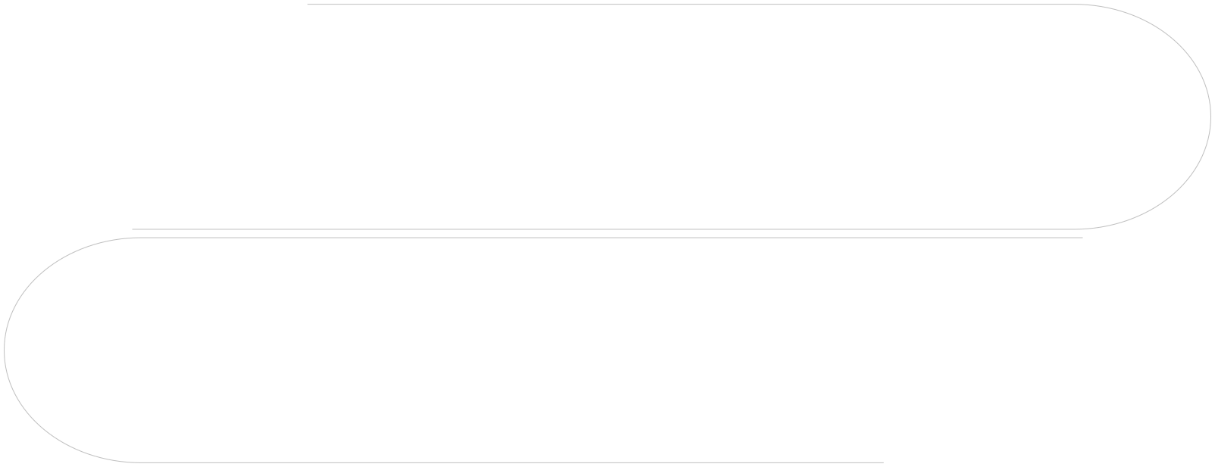

  STEP BY STEP JOURNEY
(1) Pre-Onboarding
(2) Onboarding (Pre Check-In)
(4) Customer Support
(3) Post Check-In (During Stay)
(5) Post Check-out

Slide 4

10
  STUDENT PRE-ONBOARDING
Following are the emails and communications sent to students before the official onboarding process begins, such as initial welcome email, campaign details and introductory information to prepare them for the next steps.

Slide 5
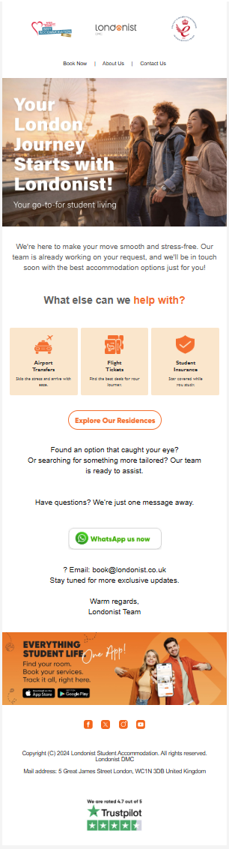
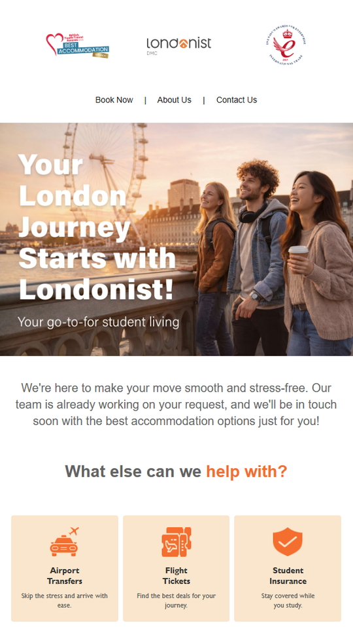
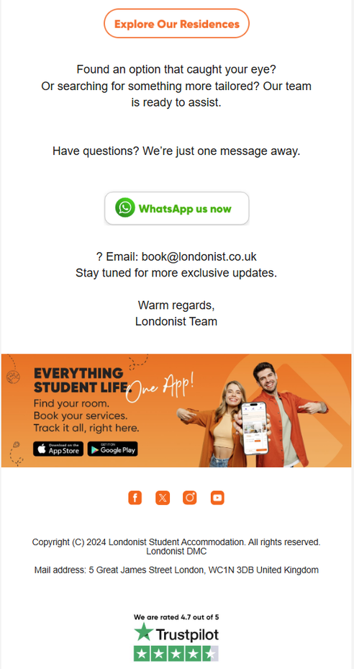
  WELCOME EMAIL
When: As soon as student fill and send enquire form to us.
From: book@londonist.co.uk
To: Student email address
How many times: 1
Action: Residence list, Contact us via whatsapp, Email and Call.

Slide 6
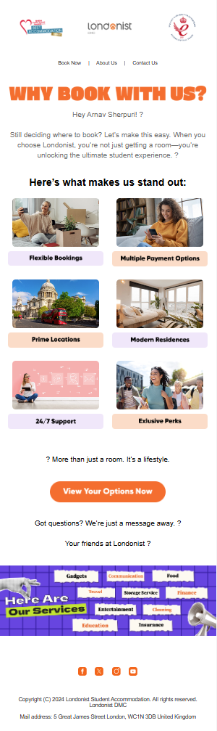
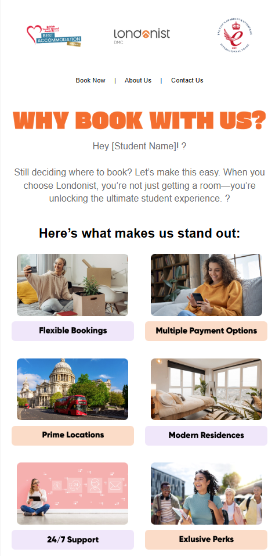
  WHY BOOK WITH US
When: As soon as lead drops into our system
From: book@londonist.co.uk
To: Student email address
How many times: 1
Action: Residence Detail page

Slide 7
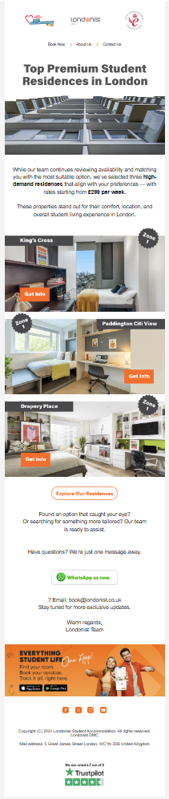
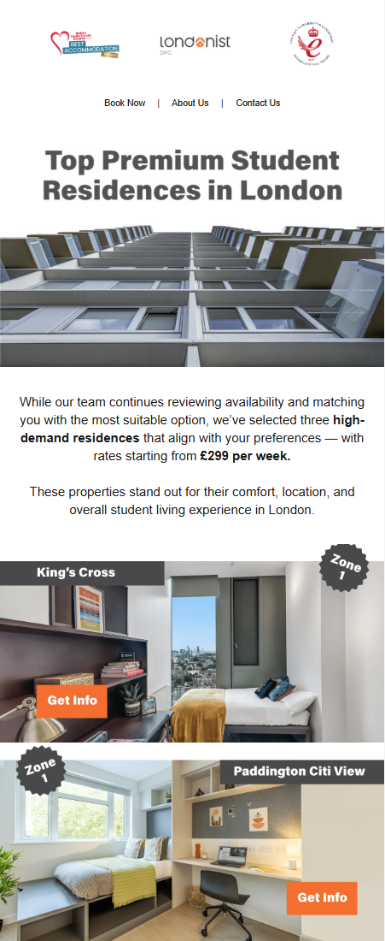
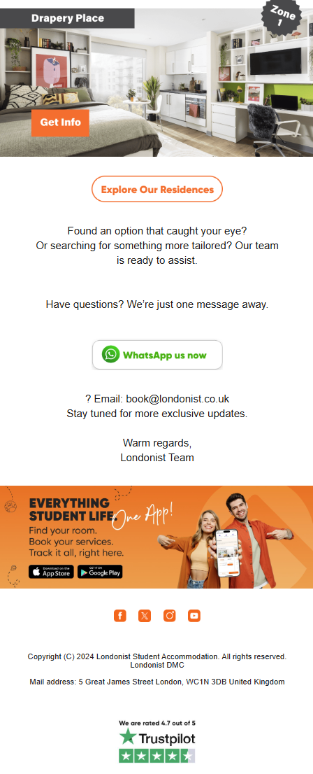
  SHORT LIST EMAIL
When: Soon after Welcome Email
From: book@londonist.co.uk
To: Student email address
How many times: 1
Action: Residence Detail Page

Slide 8
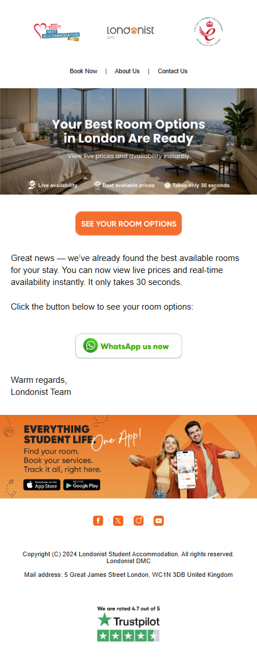
  QUOTE WIZARD TEMPLATE
When: Soon after Welcome Email
From: book@londonist.co.uk
To: Student email address
How many times: 1
Action: Quote Wizard (Offer)

Slide 9
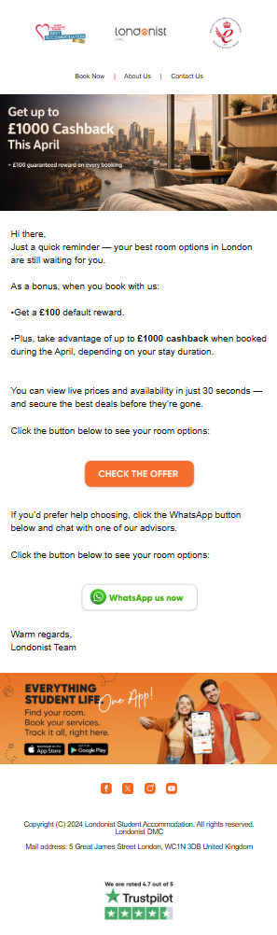
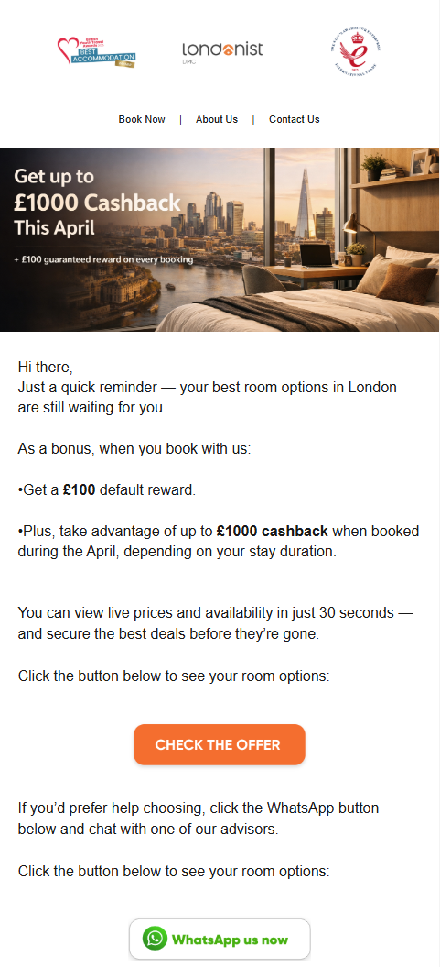
  QUOTE WIZARD REMINDER TEMPLATE
When: 2 days after sending quote wizard template and no response is received
From: book@londonist.co.uk
To: Student email address
How many times: 1
Action: Quote Wizard (Offer)

Slide 10
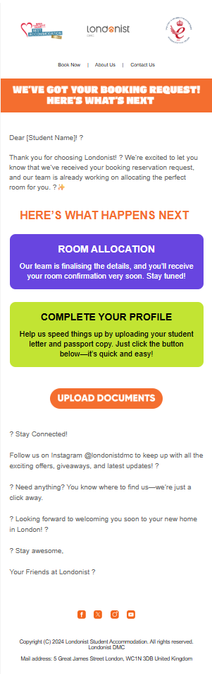
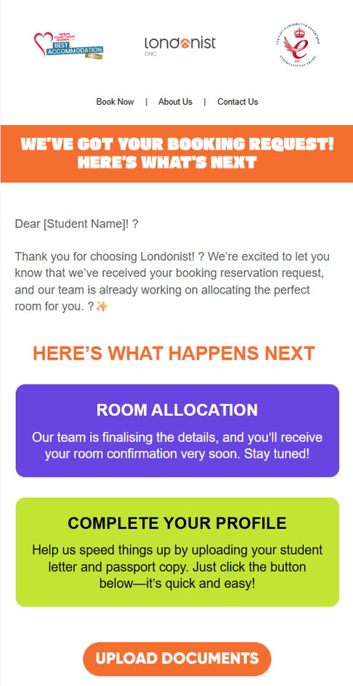
  BOOKING CONFIRMATION - INSTANT BOOKING
When: Soon after students does instant booking from website
From: reservations@londonist.co.uk
To: Student email address
How many times: 1
Action: Upload Documents (Copy of Passport and Offer Letter)

Slide 11
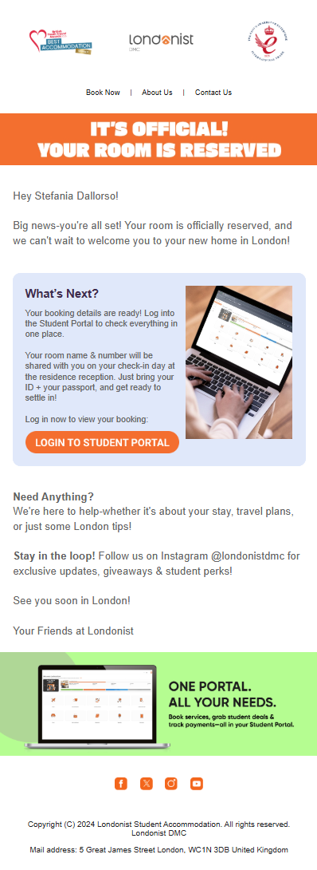
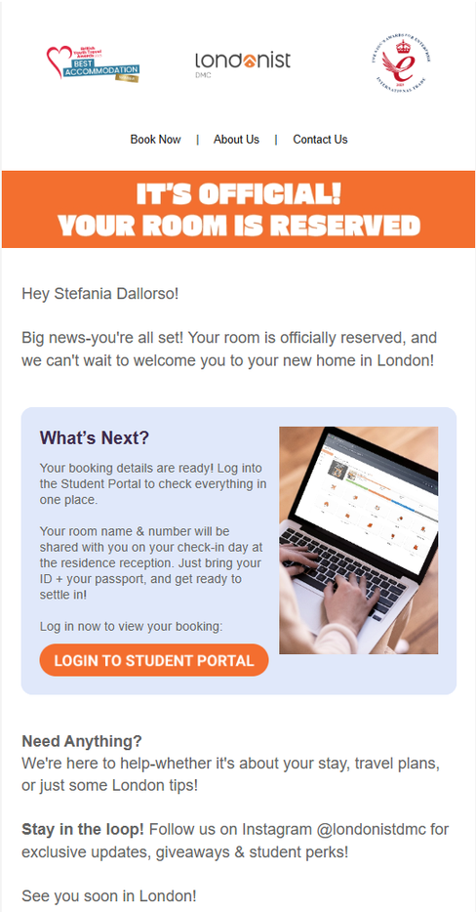
  ROOM LOCKED
When: Soon after Instant vooking is done.
From: reservations@londonist.co.uk
To: Student email address
How many times: 1
Action: Student Portal link

Slide 12
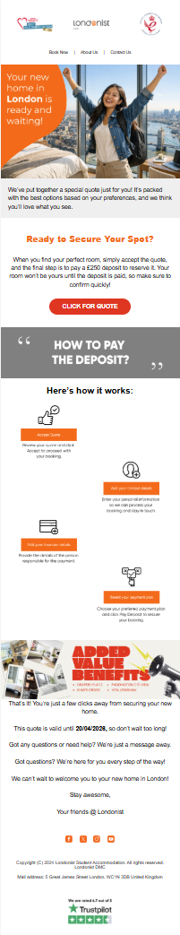
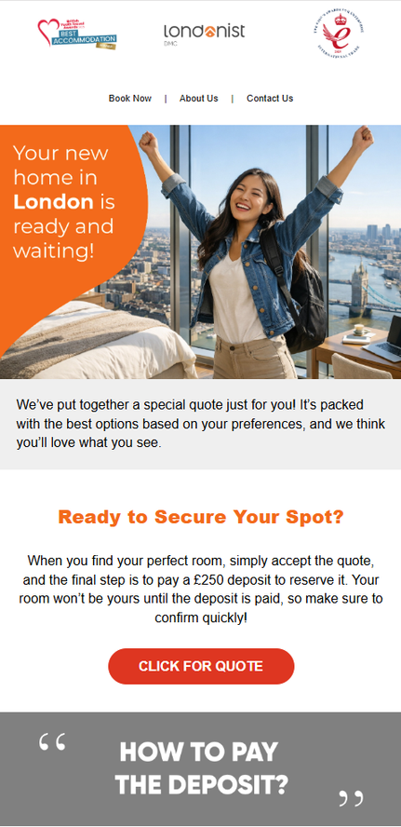
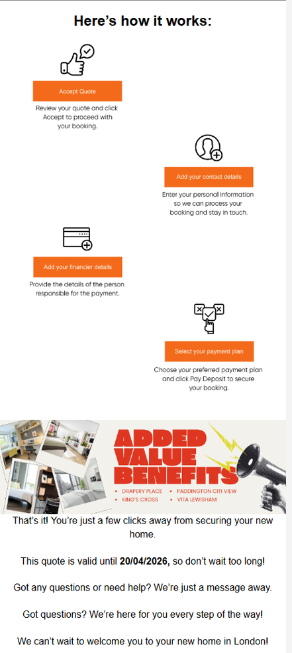
  QUOTE EMAIL
When: When Sales agents send quote to students
From: reservations@londonist.co.uk
To: Student’s email address
How many times: 1 (it depends on how many times sales agents send quote)
With Which Action: View Quote details

Slide 13
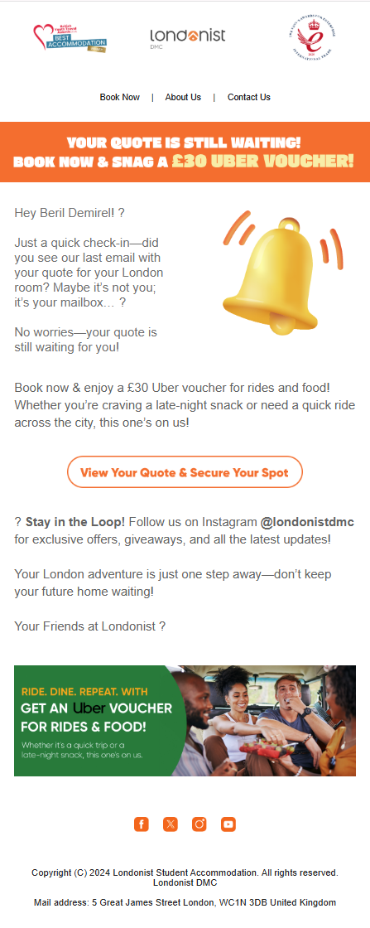
  QUOTE NOT SEEN EMAIL
When: If student has received the email but he didnt see it in 24 hours.
From: reservations@londonist.co.uk
To: Student’s email address
How many times: 1
With Which Action: View Quote details

Slide 14
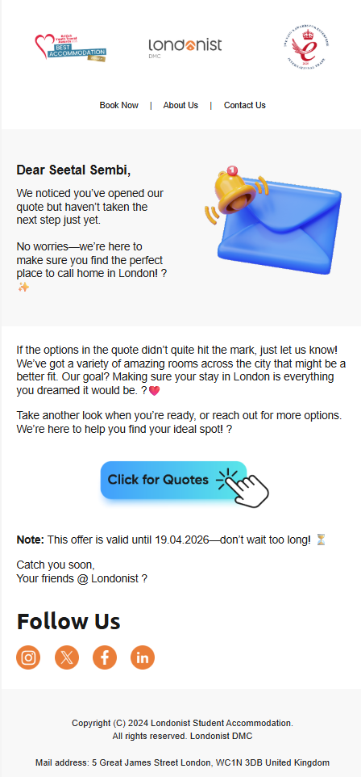
  QUOTE REMINDER
When: If student has received the quote but not accepted within 48 hours.
From: reservations@londonist.co.uk
To: Student’s email address
How many times: 1
With Which Action: View Quote details.

Slide 15
  STUDENT ONBOARDING AND PRE CHECK-IN
Following are the emails and communications sent to students prior to arrival, covering arrival essentials, check-in details & instructions and travel details to ensure a smooth check-in process.
13
Note: Some of these communications are scenario-based, such as deposit reminders or onboarding pack notifications if not yet purchased.

Slide 16
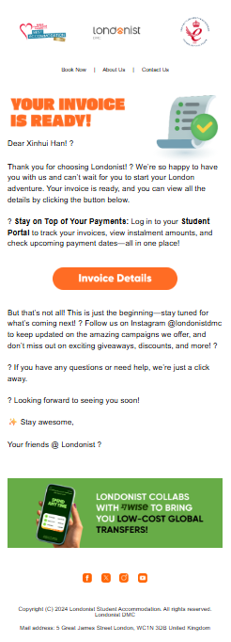
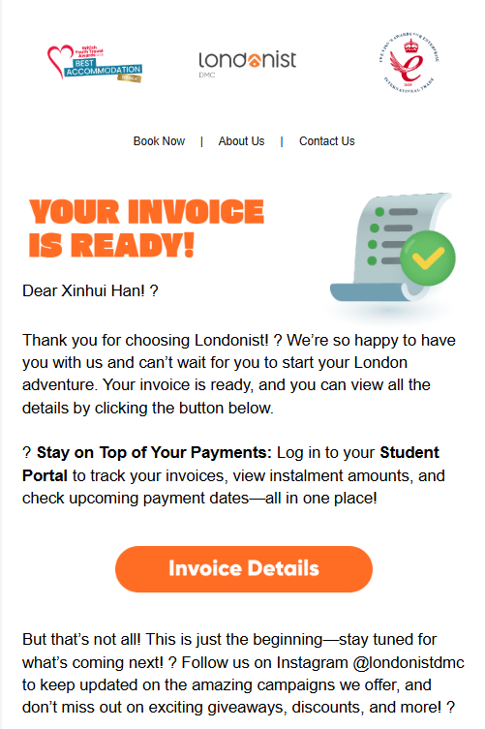
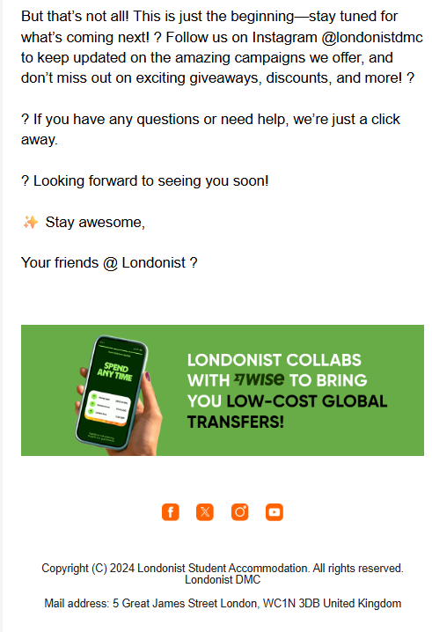
  INVOICE EMAIL
When: Student has accepted the quote but not paid 250 deposit.
From: reservations@londonist.co.uk
To: Student’s email address
How many times: 1
With Which Action: Student portal link to check Invoice and Review on Trustpilot.

Slide 17
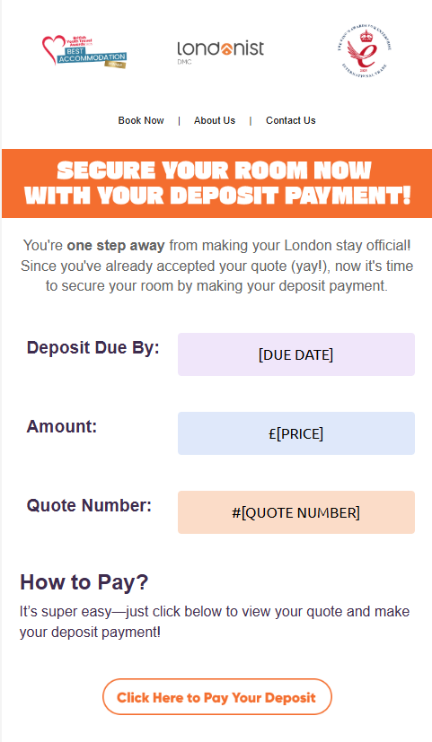
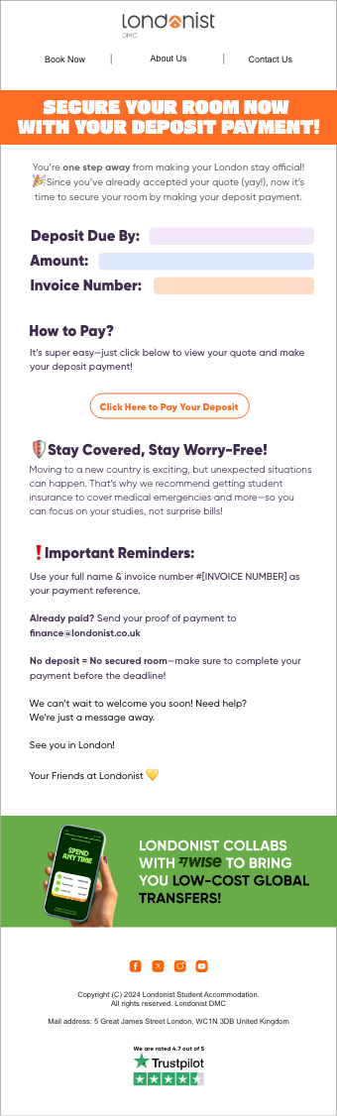
  DEPOSIT REMINDER - EMAIL
When: Student has accepted the quote but not paid the deposit yet.
From: finance@londonist.co.uk
To: Student’s email address
How many times: 1
With Which Action: Complete your payment on accepted quote.

Slide 18
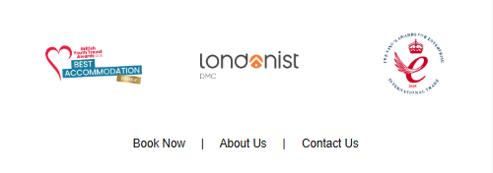
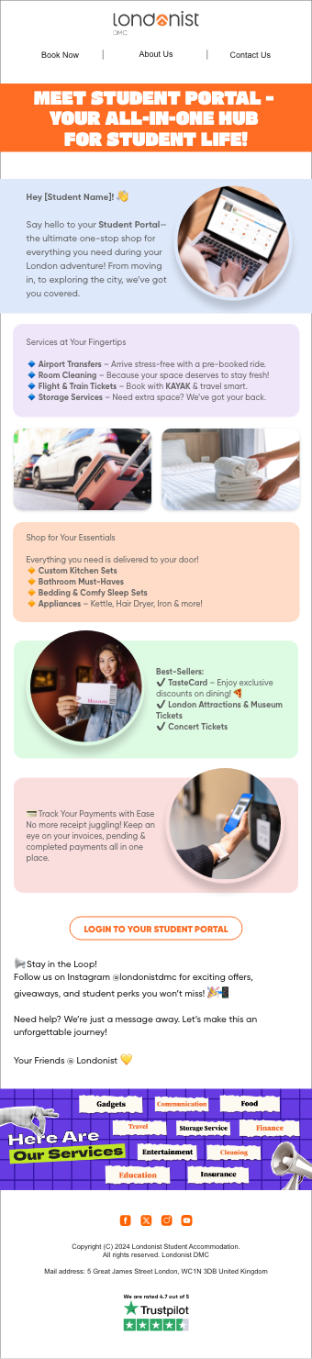
  STUDENT PORTAL EMAIL
When: Soon after booking details are sent to student
From: customersupport@londonist.co.uk
To: Student’s email address
How many times: 1
Action: Login to portal and buy additional services/products

Slide 19
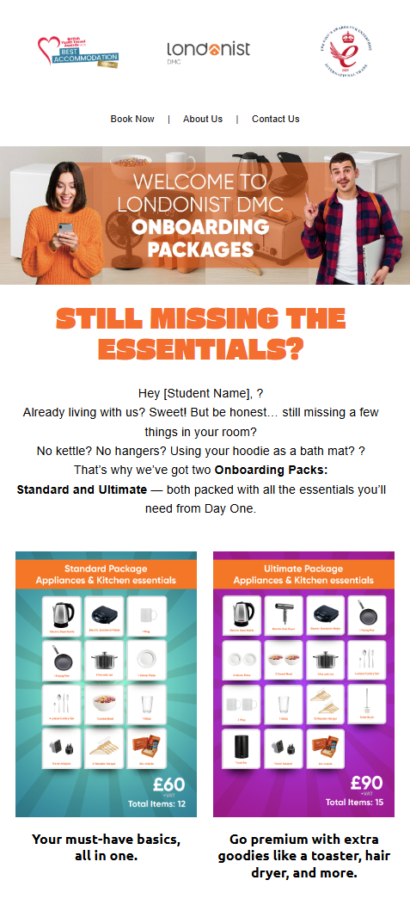
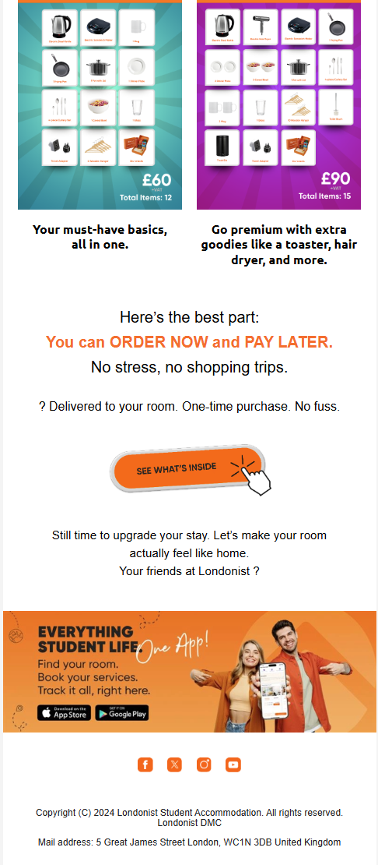
  ONBOARDING PACK - 1
When: Right after booking is done and onboarding pack is not bought
From: reservations@londonist.co.uk
To: Student email address
How many times: 1
Action: Onboarding Pack Landing Page

Slide 20
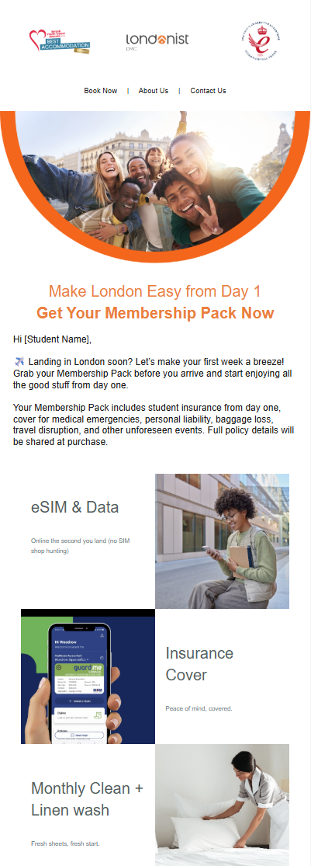
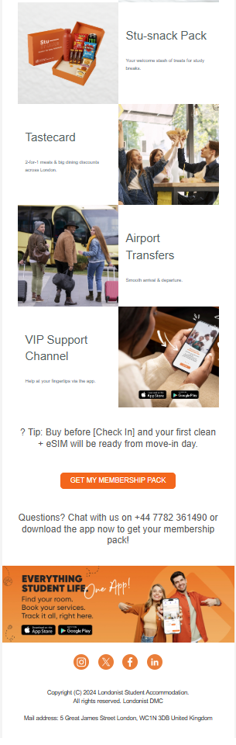
  MEMBERSHIP PACK - 1
When: 4 Days Before Checkin
From: studentclub@londonist.co.uk
To: Student email address
How many times: 1
Action: Login to portal and buy membership pack

Slide 21
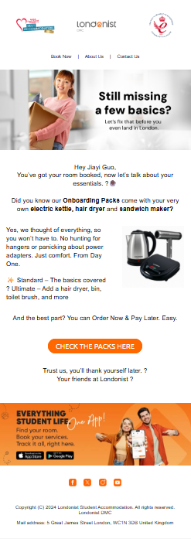
  ONBOARDING PACK - 2
When: 10 days after booking
From: customersupport@londonist.co.uk
To: Student email address
How many times: 1
Action: Onboarding Pack Landing Page

Slide 22
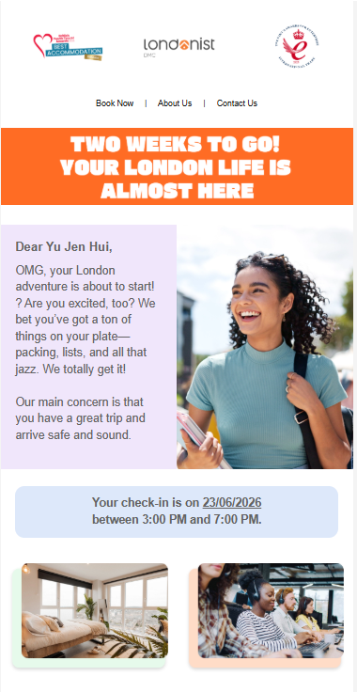
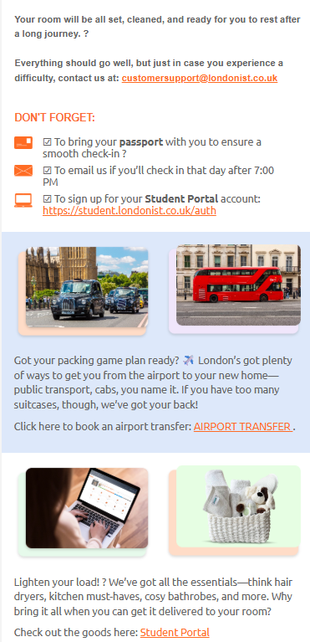
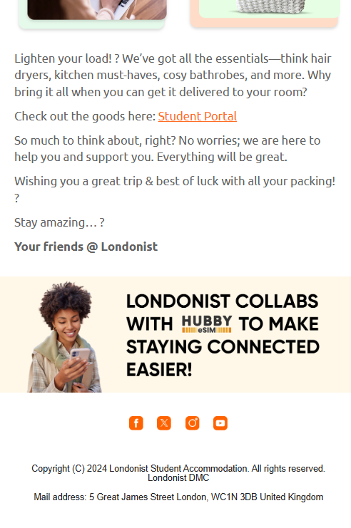
FIRST CHECK-IN REMINDER
When: 14 days before student’s check-in date
From: reservations@londonist.co.uk
To: Student’s email address
How many times: 1
Action: Student portal link to buy essentials and airport transfer

Slide 23
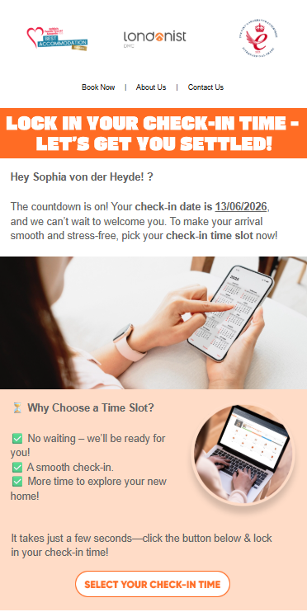
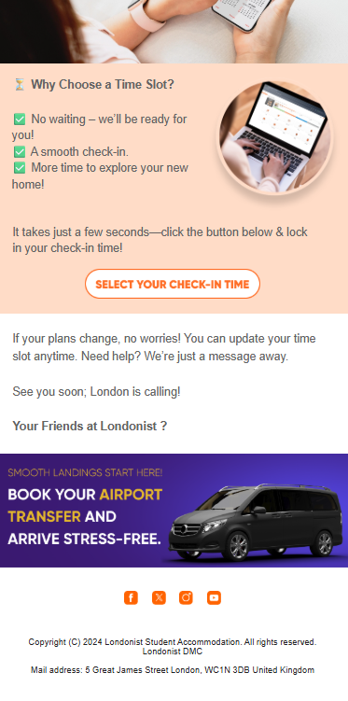
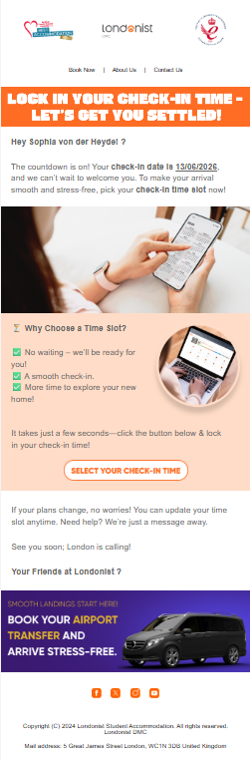
  CHECK-IN TIME SELECTION
When: 5 days before check-in
From: reservations@londonist.co.uk
To: Student’s email address
How many times: 1
Action: Choose your arrival date and time.

Slide 24
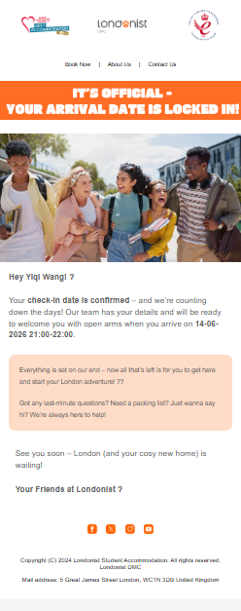
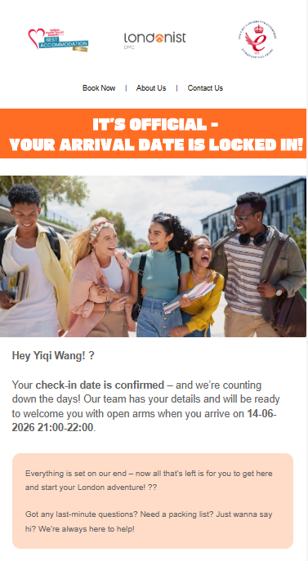
  CHECK-IN TIME CONFIRMATION
When: Student has successfully selected arrival time
From: reservations@londonist.co.uk
To: Student’s email address
How many times: 1
With Which Action: None.

Slide 25
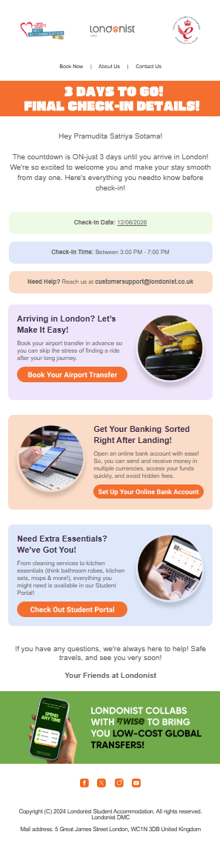
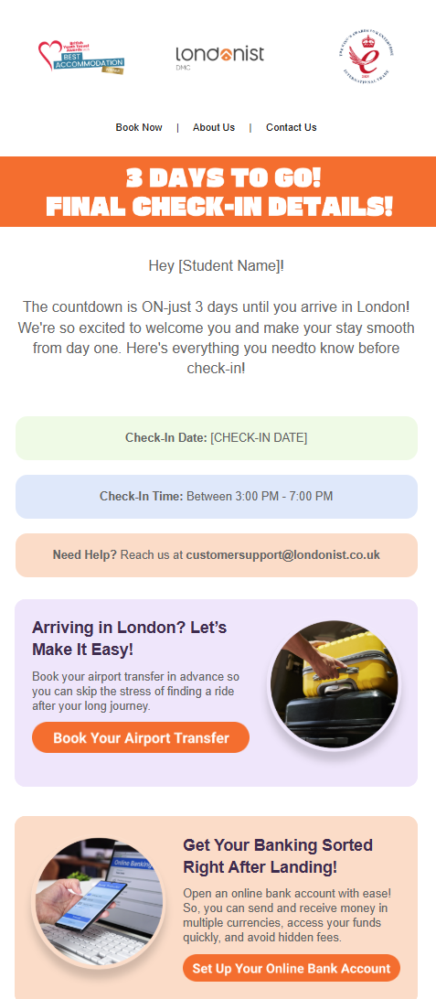
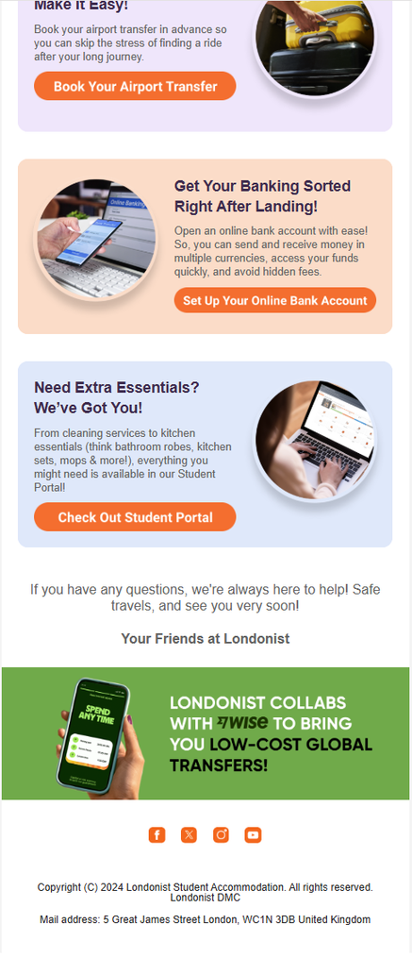
  SECOND CHECK-IN REMINDER
When: 3 days before check-in
From: reservations@londonist.co.uk
To: Student’s email address
How many times: 1
Action: Login to portal and book Airport Transfer, open wise account and buy essentials.

Slide 26
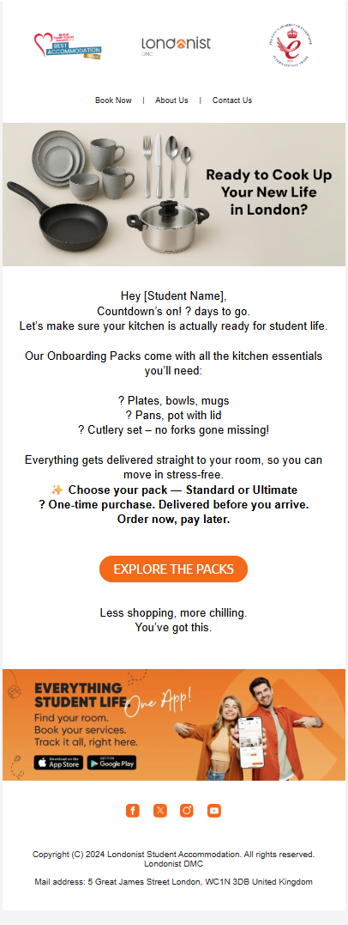
  ONBOARDING PACK EMAIL - 3
When: 10 days before check-in
From: customersupport@londonist.co.uk
To: Student email address
How many times: 1
Action: Onboarding Landing Page

Slide 27
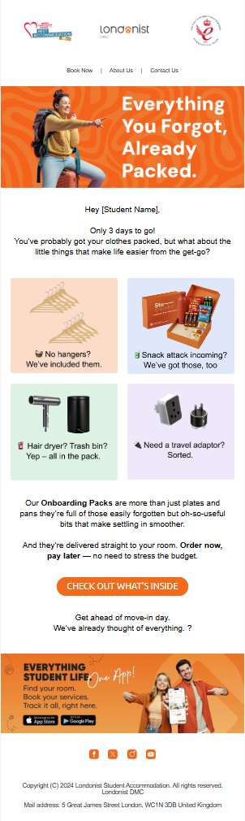
  ONBOARDING PACK EMAIL - 4
When: 3 days before check-in
From: customersupport@londonist.co.uk
To: Student email address
How many times: 1
Action: Onboarding Landing Page

Slide 28
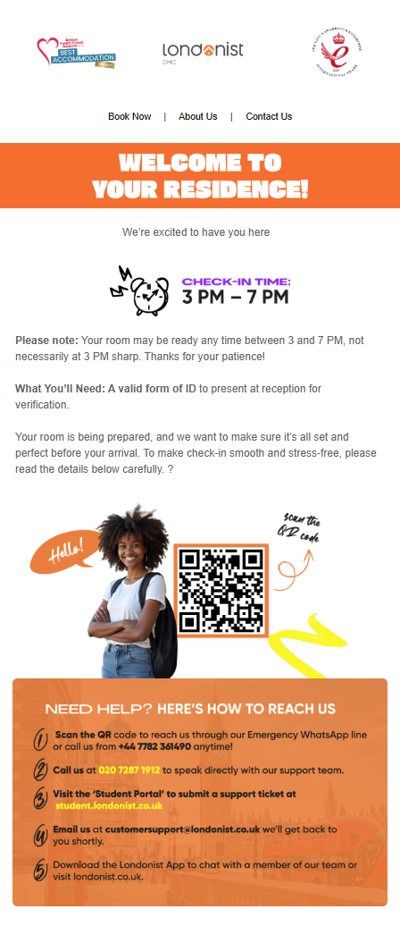
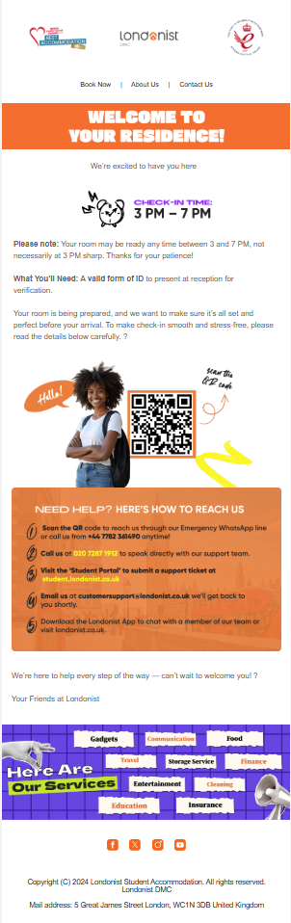
  CHECK-IN INSTRUCTIONS VIA EMAIL
When: On their booking date, 7 days before check-in date and 1 day befor check-in date
From: reservations@londonist.co.uk
To: Student’s email address
How many times: 3
Action: Support WhatsApp number, Student Portal Link, Support Landline number.

Slide 29
  CANCELLATION REQUESTS
Following Auto emails are sent to student based on cancellation request made by student through student portal
2

Slide 30
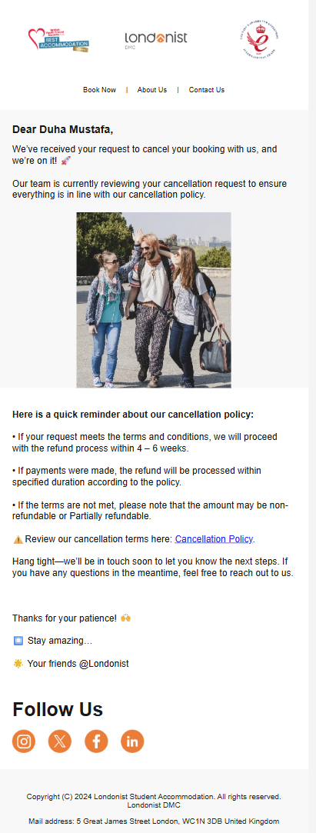
  BOOKING CANCELLATION REQUEST
When: As soon as student submits cancellation request from portal
From: reservations@londonist.co.uk
To: Student’s email address
How many times: 1
With Which Action: Review Cancellation Policy

Slide 31
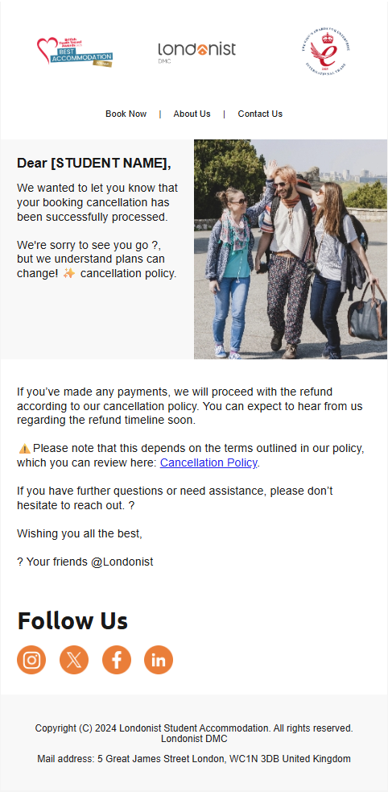
  BOOKING CANCELLATION CONFIRMATION
When: As soon as finance team confirms the request through MP
From: reservations@londonist.co.uk
To: Student’s email address
How many times: 1
With Which Action: Review Cancellation Policy.

Slide 32
22
  POST CHECK-IN & DURING STAY
Following are the emails and communications sent to students throughout their stay, providing important updates, support information, and reminders.

Slide 33



  ONBOARDING PACK EMAIL - 5
When: 2 days after check-in
From: customersupport@londonist.co.uk
To: Student’s email address
How many times: 1
With Which Action: Onboarding Landing Page

Slide 34

  MEMBERSHIP PACK - 2
When: 2 days after Checkin
From: studentclub@londonist.co.uk
To: Student’s email address
How many times: 1
With Which Action: Login to portal and buy membership pack

Slide 35

  HUBBY ESIM EMAIL
When: 3 days after check-in
From: reservations@londonist.co.uk
To: Student’s email address
How many times: 1
With Which Action: Hubby eSIM Link - Student Portal

Slide 36



  WISE EMAIL
When: 5 days after check-in
From: reservations@londonist.co.uk
To: Student’s email address
How many times: 1
With Which Action: Wise Link - Student Portal

Slide 37


  DURING STAY
When: 5 days after check-in
From: reservations@londonist.co.uk
To: Student email address
How many times: 1
Action: Brompton, London Attractions, Ticketmaster, Musement, Bus Tours, Train Tickets and Trustpilot link.

Slide 38


  TASTE CARD EMAIL
When: 10 days after check-in
From: reservations@londonist.co.uk
To: Student’s email address
How many times: 1
With Which Action: Taste Card Link - Student Portal

Slide 39


  CUSTOMER SUPPORT EMAIL
When: 7 days after check-in
From: reservations@londonist.co.uk
To: Student’s email address
How many times: 1
Action: Student Portal Login

Slide 40


  KAYAK
When: 7 days after check-in
From: reservations@londonist.co.uk
To: Student’s email address
How many times: 1
Action: Kayak and Airport Transfer link through Student Portal Login

Slide 41


  MUSEMENT, LONDON ATTRACTIONS AND BUS/TRAIN TICKETS
When: 2 weeks after checkin date
From: reservations@londonist.co.uk
To: Student’s email address
How many times: 1
Action: Musement, Ticket Master, London Attractions, Bus Tours and Train Tickets.

Slide 42


  GROSS INVOICE
When: When Gross invoice is sent to student
From: reservations@londonist.co.uk
To: Student email address
How many times: 1 (Its manual process so can be sent as many times as needed)
With Which Action: View and accept License agreement

Slide 43


  COE
When: When sales agent send COE document to students/partners
From: reservations@londonist.co.uk
To: Student email address
How many times: 1 (Its manual process so can be sent as many times as needed)
With Which Action: View and accept License agreement

Slide 44


  LICENSE AGREEMENT
When: When invoices are updated/amended
From: reservations@londonist.co.uk
To: Student’s email address
How many times: 1 (Its manual process so can be sent as many times as needed)
With Which Action: View and accept License agreement

Slide 45


  RECEIPT EMAIL
When: Finance team sends confirmation of received payment
From: finance@londonist.co.uk
To: Student’s email address
How many times: 1 (It Depends on how many times finance team sends receipt)
With Which Action: Download Receipt.

Slide 46


  AFTER CHECK-IN FEEDBACK
When: 14 days after check-in
From: reservations@londonist.co.uk
To: Student’s email address
How many times: 1
Action: Trustpilot Review

Slide 47


  UPCOMING PAYMENT REMINDER
When: 3 and 7 days before payment date.
From: finance@londonist.co.uk
To: Student email address
How many times: 2
With Which Action: Login to portal and make your payment.

Slide 48


  UPCOMING PAYMENT REMINDER - PARENT/ GUARANTOR
When: 3 and 7 days before payment date.
From: finance@londonist.co.uk
To: Parent/Guarantor’s email address
How many times: 2
With Which Action: Bank Transfer or online payment.

Slide 49


  INVOICE PAYMENT OVERDUE
When: After 3 and 7 days of payment date
From: finance@londonist.co.uk
To: Student’s email address
How many times: 2
With Which Action: Student portal link to check Invoice and make payment.

Slide 50


  INVOICE PAYMENT OVERDUE FOR PARENT/ GUARANTOR
When: After 3 and 7 days of payment date
From: finance@londonist.co.uk
To: Parent/Guarantor’s email address
How many times: 2
With Which Action: Bank Transfer or online payment.

Slide 51


  CHECK-OUT REMINDER
When: 14 and 3 days before check-out date
From: reservations@londonist.co.uk
To: Student’s email address
How many times: 2
Action: Book Airport Transfer

Slide 52


  EXTENSION MAILING - 1
When: 15 days before check-out Date
From: reservations@londonist.co.uk
To: Student email address
How many times: 1
With Which Action: Whatsapp Chat for extension request and get free cleaning

Slide 53


  EXTENSION MAILING - 2
When: 10 days before check-out Date
From: reservations@londonist.co.uk
To: Student’s email address
How many times: 1
With Which Action: Whatsapp Chat for extension request and get free cleaning

Slide 54


  EXTENSION MAILING - 3
When: 5 days before check-out Date
From: reservations@londonist.co.uk
To: Student email address
How many times: 1
With Which Action: Whatsapp Chat (General Sales number) for extension request and get free cleaning

Slide 55
  CUSTOMER SUPPORT
Following are the emails and communications sent to students when there is any complaint or request registered by student through multiple channels.
3

Slide 56

  TICKET REGISTERED BY STUDENT
When: As soon as student submits request via student portal or explains issue on Live chat.
From: studenthelp@londonist.co.uk
To: Student’s email address
How many times: 1
With Which Action: Student Portal Link

Slide 57

  UPDATE ON STUDENT’S TICKET
When: As soon as there is update on student’s request
From: studenthelp@londonist.co.uk
To: Student’s email address
How many times: 2
Action: Student Portal Link

Slide 58

  UPDATE ON STUDENT’S TICKET RESOLUTION
When: As soon as the student request is resolved.
From: studenthelp@londonist.co.uk
To: Student’s email address
How many times: 1
Action: Student Portal Link

Slide 59
4
  POST CHECK-OUT
Following are the emails and communications sent to students post check-out, including feedback requests

Slide 60


DEPOSIT REFUND EMAIL
When: 1 day after Check-out date
From: finance@londonist.co.uk
To: Student email address
How many times: 1
With Which Action: Tutorial on how to request deposit refund

Slide 61

  DEPOSIT REFUND REQUEST RECEIVED
When: As soon as student submits refund request
From: finance@londonist.co.uk
To: Student’s email address
How many times: 1
With Which Action: None

Slide 62

  DEPOSIT REFUND REJECTION
When: As soon as finance team rejects the request through MP
From: finance@londonist.co.uk
To: Student’s email address
How many times: 1
With Which Action: Asking student to resubmit request with correct details.

Slide 63


  AFTER CHECK-OUT FEEDBACK
When: 14 days after check-out date
From: reservations@londonist.co.uk
To Who: Student’s email address
How many times: 1
With Which Action: Trust Pilot review

Slide 64
  MEMBERSHIP AND ONBAORDING PACK THROUGH STUDENT PORTAL - AUTO EMAILS
Following Auto emails are sent to student based on request made by student to buy, upgrade or cancel subscription on Membership packs through student portal
4

Slide 65


  MEMBERSHIP SUBSCRIPTION
When: As soon as student buys Membership pack from Student Portal
From: reservations@londonist.co.uk
To: Student’s email address
How many times: 1
With Which Action: Student Portal Link

Slide 66


  MEMBERSHIP SUBSCRIPTION UPGRADE
When: As soon as student upgrades Membership pack from Student Portal
From: reservations@londonist.co.uk
To: Student’s email address
How many times: 1
With Which Action: Student Portal Link redirecting to membership packs

Slide 67


  MEMBERSHIP UNSUBSCRIPTION
When: As soon as student unsubscribes Membership pack from Student Portal
From: reservations@londonist.co.uk
To: Student’s email address
How many times: 1
With Which Action: Student Portal Link

Slide 68

  ONBOARDING PACK
When: As soon as student buys Onboarding pack from Student Portal
From: reservations@londonist.co.uk
To: Student email address
How many times: 1
With Which Action: Student Portal Link

Slide 69
LONDONIST DMC STUDENT GUEST JOURNEY
  END OF GUEST JOURNEY
JULY 2026

